Slide 1

The Importance of Crime Scene Investigation as Demonstrated by a Case Study
Jon R. Thogmartin M.D.

Slide 2
Initial Observations
Loud bang heard 6–6:30 am
  Police notified
Body found at the bottom of a driveway
The point of impact was found 10 feet away from the body
Minimal tissue traces between body and point of impact
Reports of tire tracks on the body were made
ME arrived 2.5 hours later
Notes:
Resident who heard the noise called the police
Before the ME arrived the police covered the body with a sheet to prevent onlookers and media coverage
Point of impact was a collection of blood and tissue

Slide 3
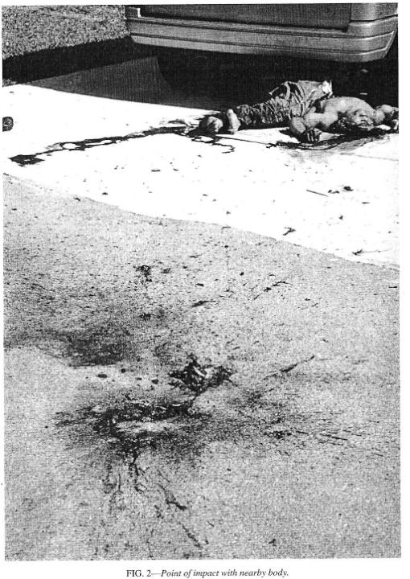

Slide 4
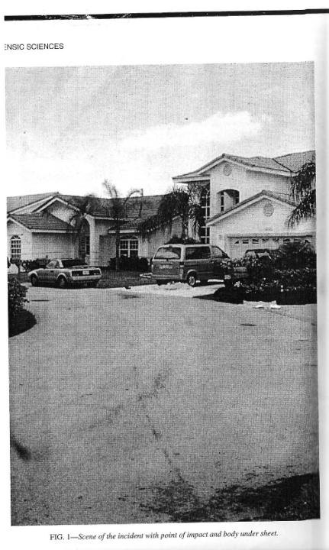

Slide 5
Residence
Van
Truck
X=body location *=impact site
X
Car
*
Residential Street
N
Notes:
There were 2 cars in the driveway and one on the street, facing west, none of which were involved
The street makes a 90 degree turn just to the east of the body

Slide 6
What do you think happened?
Initially thought to be a motor vehicle/pedestrian incident
Further investigation showed it wasn’t a typical incident

Slide 7
Residence
Van
Truck
X=body location *=impact site
b=brain S=skull
b₂=brain in palm tree ~6 feet above the ground
S
X
b
Car
*
Residential Street
b
b₂b
Residence
N
Notes:
Skull fragment found on front porch of a house 70 ft from the body
Brain matter found in a palm tree 6 ft off the ground and 40 ft away from the body
Other pieces of brain matter found on a nearby mailbox 3 ft off the ground, and also 60 ft down the street
A piece of muscle with attached tendon was found on the driver’s side mirror of an automobile in an adjacent driveway
A piece of dura was found in the back of a nearby pickup truck
Minute fragments of brain matter found in nearby vegetation
These fragments were found in all directions from the point of impact

Slide 8
Scene Investigation
The skin was cool, but the organs were warm
The body had on jeans only
One shoe was found nearby
No wallet or ID found
Pockets contained an unopened condom and a torn picture showing the bottom half of a person
Notes:
The temp of the organs was found by direct touch, which was possible because of massive injuries

Slide 9
Scene Investigation
Grease found on the body (previously thought to be tire marks)
Multiple fractures
Partial evisceration (disemboweled)
Open cranium with absent brain
  Brain matter and skull fragments found at the point of impact
No bloody tire tracks were found on the scene

Slide 10
Autopsy
Male, late 20’s, early 30’s
Multiple fractures
Minimal abrasions
Acute striae on inguinal areas (groin or lower abdomen), anterior left arm, and mid-thighs
Notes:
Fractures: spine, extremities, ribs, clavicles, pelvis, and skull
Abrasions: typical abrasions and tire marks of a pedestrian/motor vehicle incident absent

Slide 11
Autopsy
8X2 cm laceration on the right shoulder
Internal organs were extensively lacerated and/or pulpified
Toxicology was negative

Slide 12
Autopsy
ID was never made
Several tattoos present
  A badge/shield with “Racing” on it, possibly an Argentinian football (soccer) team
The torn picture was consistent with a person wearing a soccer jersey
The condom was from the Dominican Republic
Notes:
Tattoo: there is a soccer team in Avellaneda
A similarly named soccer team located in Uruguay

Slide 13
Discussion
Injuries could be consistent with:
  High-speed motor vehicle/pedestrian incident
    Could a vehicle make the turn at the speed necessary?
    Body was only 10 ft. from point of impact
    Lack of skid marks and vehicle debris
  Low-speed rollover by a large vehicle
    Lack of tire marks on the body or bloody tire tracks

Slide 14
Discussion
The scene was in the flight path of Miami International Airport
There was a lack of tall buildings in the area
Theorized that he could have fallen from the wheel-well as a stowaway
The height and distance at which the landing gears are lowered is consistent with this theory
Notes:
Many commercial jets flew by with lowered or lowering landing gear while they were processing the scene
According to air traffic control at Miami International Airport, the jets lower the landing gear at an altitude of 1500 ft at about 170 knots, which would allow the body to reach terminal velocity
About 60 m/s, according to the article
Landing gears are lowered 6 to 7 miles from the airport, which is consistent with the distance of the scene to the airport

Slide 15
Discussion
The massive head, thoracic, pelvic and visceral injuries are consistent with a fall from over 100 ft
The fall would also account for the brain and tissue cast off in multiple directions
Several indentions were present in the asphalt at the impact site
Lack of blood between the body and impact site is consistent with the body “bouncing”
Notes:
The injuries are similar to those described in parachute accidents
The distances of the cast off shows the energy of the impact
The indentions were surrounded with blood, but free of blood
From bony parts hitting the pavement at the same time as the body, particularly the head, and partially disintegrating
Lack of blood is also inconsistent with a traffic incident

Slide 16
Discussion
It is common for wheel-well stowaways to fall to their death
The wheel well is unpressurized
Hyperthermia and hypoxia (deficiency of oxygen reaching tissues) are generally experienced
Frostbite and fatal freezing are common
Other hazards include decompression sickness and being crushed by the landing gear
Notes:
Airplanes typically reach above 30,000 ft with temps at -45 degrees C and ppO₂ below 47 mmHg

Slide 17
Discussion
The grease found on the body is probably due to the hydraulics and landing gear
No frost was found on the body
  It was a warm day
  The ME took 2.5 hours to get to the body

Slide 18
Discussion
At Miami International Airport, planes depart and land against prevailing winds
  That day, winds were from the east
CSI could have been impeded if he landed:
  On a busy roadway
  In a remote area
CSI would have been easier if he landed:
  On a roof
  In a backyard
Notes:
This means planes were approaching from the west, which is over land
Had the winds been from the west, the body would have likely landed in the Atlantic Ocean, and he might not have been discovered
Cars would have run over him on a busy roadway and left tire marks
He might not be discovered for weeks or months in a deserted area

Slide 19
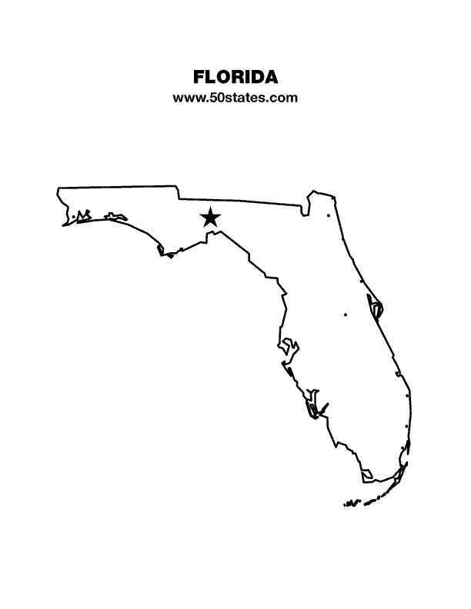

WIND

Slide 20
Conclusion
The injuries displayed could have been consistent with a large or high-speed motor vehicle/pedestrian accident, but many findings were inconsistent with that
A stowaway was the most likely explanation
This case demonstrates the importance of thorough crime scene investigation
Notes:
He probably fell due to hypoxia or hypothermia upon landing

Slide 21
Fatal Fall of an Aircraft Stowaway: A Demonstration of the Importance of Death Scene Investigation
Jon R. Thogmartin, M.D.

